Slide 1
Continous Integration, Delivery, Deployment, and DevOps
Dit191/Eda397 Agile Development Processes
Eric Knauss

Slide 2
Agenda today
Current research challenges
Acceptance testing schedule
Next week Tuesday
2nd Meeting with Student representatives
Optional: Discuss exam
Job opportunities (interested? Contact Eric)
Summer job: Machine Learning/Mining Software Repositories
Teaching Assistant: Requirements Engineering, Sept-Oct

Slide 3
Agile workshop – Acceptance Test No 3.
May-12 13:15-15:45
Welcome to the third Acceptance Test for the Android App project.
Each group will have 30 minutes to show current status and features of their project on to discuss the use of an Agile development approach.
Please note the time restrictions, meaning “Be on time!”
All group members should bring their laptop where the App should be demonstrated and the development environment (i.e. Trello, Github) should also be accessible.
If you can’t attend, please tell us (Magnus/Terese) via mail before.

Slide 4
Acceptance Test - Schedule Group 1-5 Day: Thursday Focus: Meeting with customer – demo and planning
Room: Room 321, 3th Floor in house Jupiter
Supervisor: Terese Besker
Time (30 min/each) | Group | Spokesperson
13.15 – 13.45 | 5 | Wissam Alfreijat
13.45 – 14.15 | 4 | Sofia Edström
14.15– 14.45 | 3 | Sebastian Blomberg
14.45 – 15.15 | 2 | Dominik Muth
15.15 – 15.45 | 1 | Pedram Shirinbolaghi

Slide 5
Acceptance Test - Schedule Group 6-9 Day: Thursday Focus: Meeting with customer – demo and planning
Room: Room 322, 3th Floor in house Jupiter
Supervisor: Magnus Ågren
Time (30 min/each) | Group | Spokesperson
13.15 – 13.45 | 9 | Fredrik Holmdahl
13.45 – 14.15 | 8 | Mustafa Hussein
14.15– 14.45 | 7 | Johan Eriksson
14.45 – 15.15 | 6 | Fredrik Holmdahl

Slide 6
Meeting with customer present status and features of your project
Agile Manifest principle: Our highest priority is to satisfy the customer through early and continuous delivery of valuable software.
Acceptance test :
What features did you show the customer during last Acceptance Test?
What did you and customer agree to on last Acceptance Test?
Today and future:
What new features can you show customer today?
Any more planned activities for final acceptance test?
Customer would like to add…..
Agile Manifest principle:
Working software is the primary measure of progress

Slide 7
Coaching Meeting using an Agile development approach
“At regular intervals, the team reflects on how to become more effective, then tunes and adjusts its behavior accordingly."
Retrospective: the team reflects on what happened in the iteration and identifies actions for improvement going forward:
What worked well for us?
What did not work well for us?
What actions can we take to improve our process going forward?

Slide 8
Continuous Integration and Beyond
Current Research Challenges

Slide 9
Overview
Part 1: What and why?
Stairway to heaven (from Software Center)
Definitions of Continuous X (from NGEA)
Part 2: RE in Continuous X
RE Challenges (from RE 15)
Scaling up the planning game (from XP 16)
Part 3: Testing in Continuous X
Test prioritization and selection (RCoSE 15)
Non-functional Testing Oracle (ISSTA 16)

Slide 10
Definition of Continuous X
Part 1: What is Continuous Integration (Delivery, Deployment) and why is it important

Slide 11

Software Center
Software Center aims to develop a strategic partnership with partner companies to significantly accelerate their adoption of novel approaches to software engineering
http://www.software-center.se/partners

Slide 12

STAIRWAY TO HEAVEN
The Stairway to Heaven Model describes the stages that companies evolve through when adopting novel approaches to software engineering
Companies move through a predictable and repeatable pattern over time when evolving software engineering practices
Each transition has business, architectural, process and organizational implications
The higher up the stairway an organization climbs, the more organizational units are affected
H.H. Olsson, H. Alahyari, J. Bosch, Climbing the"" Stairway to Heaven --A Mulitiple-Case Study Exploring Barriers in the Transition from Agile Development towards Continuous Deployment of Software, 38th EUROMICRO Conference on Software Engineering and Advanced Applications (SEAA),, pp. 392-399, IEEE, 2012.
…
…
For more information please contact jan.bosch@chalmers.se

Slide 13
Organizational Categories
Enterprises: software supports internal processes and external services (e.g. banks, insurance companies)
Product oriented organizations: develop software or software intensive products that are not deployed directly by the development teams
Service companies: develop software that is hosted and deployed directly by the developing team
Matthew Bass (CMU)

Slide 14
Definitions of Continuous X
Integration
Delivery
Deployment
Contact:
Magnus Ågren, Rogard Heldal, Eric Knauss, CTH
{magagr,heldal,knauss}@chalmers.se

Slide 15

Context
This is joint work with Agneta Nilsson
Synergies with Software Center Project 1 Implications of Continuous Deployment”
Based on group interviews with 6 companies + cross-organizational workshops for consolidating results
Research goal:
Many definitions, many concepts (Continuous Integration, Continuous Delivery, Continuous Deployment, …)
Understand which aspects are important in practice
Agree on shared language = Common Understanding

Slide 16
Continuous Integration
From Literature
Integrate new or changed code with the mainline codebase at frequent time intervals
Integrate / Test
Sufficient quality of codebase
One Mainline / Several
As long as each carry customer value
Frequency Weeks / Days / Instant
Why do we integrate – to get feedback
Integrate and test new or changed code with a codebase to enable feedback whenever we want
From Interview
Synthesis

Slide 17
Continuous Deployment
The ability to release software whenever we want
Release and Install in running / Deliver
Higher quality level of codebase
Strong quality assurance
The ability to release and install software in running system whenever we want
Otherwise: Continuous Delivery

Slide 18
Something in between…
Continuous Integration often on team level
Continuous Deployment implies the whole organization to work in a continuous way
Enterprise Continuous Integration [Ståhl and Bosch 2015]
Continuous X includes a number of dimensions

Slide 19
Summary / Proposed Terminology
 |  | Target/Receiver
 |  | Other team/unit | Internal Customer | Development partner | Consumer
Range of Flow | 1. Integration (Integrate to test and learn about the quality and fit of the delta)
 | 2. Delivery (Deliver a delta to a target/receiver (no active test and learning))
 | 3. Deployment (Deploy to a target/receiver’s runtime)
“There is no best practice, only most suited!”

Slide 20
Current work
Systematic Literature Review to understand different dimensions of these terms
Organizational scope
Other dimensions:
Managing architecture, requirements, business drivers
Transparency
Testing
Practical scope: Vision, Constructive, Experience
-- Customer
-- Company level
-- Department level
-- Team level
Integration --
Delivery --
Week --
Deployment --
Day --
Hour --
Technical scope
Feedback speed

Slide 21
Requirements Engineering in Continuous Software Engineering
Part 2:
Managing Requirements and Related Knowledge – continuously

Slide 22









The Need of Complementing Plan-Driven
Requirements Engineering with Emerging
Communication: Experiences from
Volvo Car Group
Ulf Eliasson, Rogardt Heldal,
Eric Knauss, Patrizio Pelliccione

Slide 23
To change plan-driven organisation when need for faster innovation and shorter time to market increases
Research Problem:

Slide 24
Research Questions
RQ1: How do requirements flow between stakeholders of automotive (software) engineering?
RQ2: Is there a need for shorter feedback loops for requirements validation?

Slide 25
Reqts. flow in automotive ecosystem
Challenge | Practices | Recommendations
Balancing under-specification and over-specification of requirements | Personal network Oral communication Assumptions | Networking On demand / Just-in-time RE Infrastructure for communication and feedback
Synchronizing cross-function and cross-system requirements | Personal network | Continuous integration and deployment
Friction for changing requirements increases over time | Workarounds | Defer commitment
Avoid premature commitment | Workarounds Oral communication | On demand / Just-in-time RE
Requirements need context | Personal network Oral communication | Rational and context as by-product
Slow feedback cycle on requirements | Personal network Oral communication | Short iterations / agile Virtual verification early
Balancing the need for oral communication and thorough documentation of requirements | Personal network Oral communication | On demand / Just-in-time RE Rationale as by-product
Find the right person for getting or giving feedback or information | Personal network Expert seeking | Facilitate networking within company and supply-chain
Sufficiently fast supplier interaction | Personal network | New business cases / opportunities for suppliers

Slide 26
Context

Slide 27

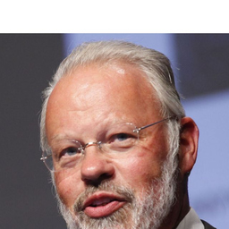
Car is a complex system
The most advanced cars have more/comparable
software than fighter airplanes …
… said by Alfred Katzenbach, the former director of
information technology management at Daimler.
Modern cars are complex distributed software in moving, safety-critical, mechatronic systems.
MODELS 2014, Agile MDE in mechatronic systems - an industrial case study, Ulf Eliasson - ulf.eliasson@volvocars.com
Notes:
Modern cars are complex, safety-critical, distributed software and mechatronic systems.
Modern cars are product lines of complex distributed software in moving, safety critical, (high voltage) volume mechatronics

Slide 28
Innovation
Reduced energy consumption
Connected cars
Autonomous cars, basically creating robots
…
… All of this requires a lot of Software!

Slide 29
Automotive Software
90% of innovation from
electronics
B. Hardung, T. Kölzow, and A. Krüger
80% of that from software
B. Hardung, T. Kölzow, and A. Krüger
The amount and complexity of
software in cars increase
C. Ebert and C. Jones,
New hybrid vehicles add even more, safety critical software!
Notes:
Hardung et al. from Audi, 2004
Ebert & Jones, 2009

Slide 30
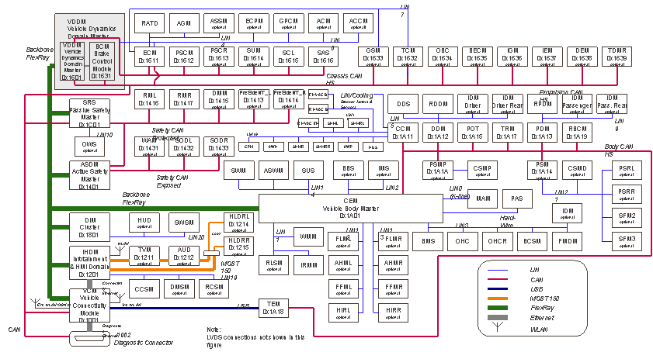
100+ ECUs
Thousands of
components
on more than
100 computers
linked to sensors
and actuators.

Slide 31






Function
F1
F2
F3
F500+
Function owner
Function
Realization
FR1
FR2
FR3
FR500+
Function Realiz.
Resp.
Driven by regulations, complexity,…!
Sub
System
SS1
SS2
SS3
SS50+
System Design
Suppliers/
In-house
2
3
4
100+
SW and HW
Design
Development Teams

Slide 32
Method

Slide 33
Method
11 semi-structured interviews (four groups):
8 interviews on information flow (Volvo Car)
3 interviews focused on the area of RE (Volvo Car)
4 semi-structured interviews for triangulation:
2 interviews on information (Volvo Truck)
2 interviews focused on the area of RE (Volvo Truck)
Ca. 45 min pr. interview

Slide 34
Subjects on all levels
Function
F1
Function owner
Function
Realization
FR1
FR2
Function Realiz.
Resp.
Sub
System
SS1
SS2
System Design
Suppliers/
In-house
2
3
SW and HW
Design
Development Teams

Slide 35
Findings

Slide 36
Research Question 1
How do requirements flow between stakeholders of automotive (software) engineering?

Slide 37
Research Question 1: How do requirements flow between stakeholders
Challenge | Practices | Recommendations
Balancing under-specification and over-specification of requirements | Personal network Oral communication Assumptions | Networking Infrastructure for communication and feedback
Synchronizing cross-function and cross-system requirements | Personal network | Continuous integration and deployment
The Cost for changing requirements increases over time | Workarounds | Defer commitment
Avoid premature commitment | Workarounds Oral communication | On demand / Just-in-time RE
Requirements need context | Personal network Oral communication | Rationale and context as by-product

Slide 38
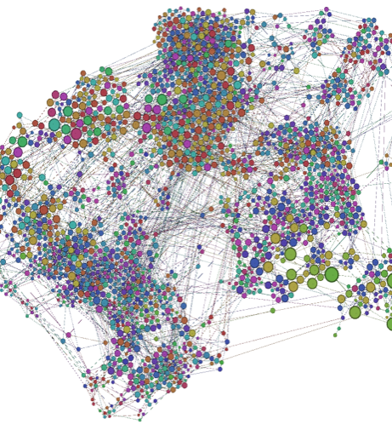
Contrasting opinions: Under-Specification and Over-Specification

Slide 39
Under-Specification
System responsible:
”… a use case is very limited, it describes, a chain of event, what should happen. And then another chain of events. But there exist a lot of other subsets of all these steps in the chain, which have no requirements stated”

Slide 40
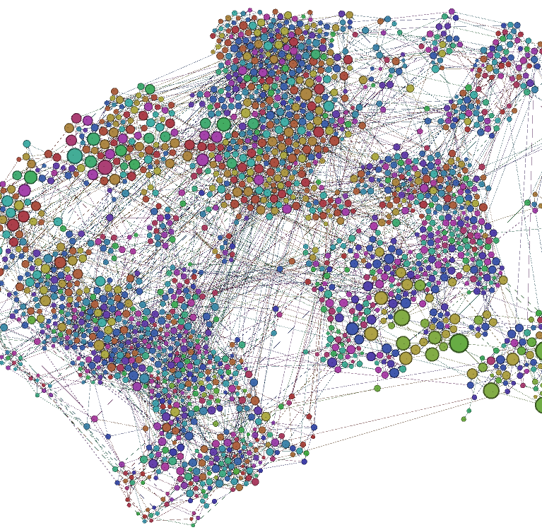
Over-Specification
System responsible:
“… we would have liked to just say: When this error occurs the battery should act like this …
Then they can decide (SW and HW designers), what does it mean to open …
Req send to their suppliers. So then it needs to be at a certain level of detail, considering that there will be no further refinement of the requirement”

Slide 41
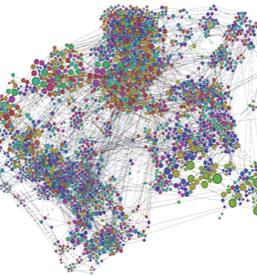
Balancing Under-Specification and Over-Specification
Practices
Personal network
Oral communication
Assumptions
Recommendations
Networking
Infrastructure for communication and feedback

Slide 42
Top down flow
Function
F1
Function owner
Function
Realization
FR1
FR2
Function Realiz.
Resp.
Sub
System
SS1
SS2
System Design
Suppliers/
In-house
2
3
SW and HW
Design
Development Teams

Slide 43

Synchronizing Cross-Function and Cross-System Requirements
System responsible:
Practices
Personal network
Recommendations
Continuous integration and deployment
“Then requirement can come from other directions as well, e.g., base technology, attribute requirements can directly impact us, even architectural requirement and cross-requirements from other sub-systems, or rather from other functions.”

Slide 44
The Cost for Changing Requirements Increases Over Time
System Responsible:
“as the project progress, new gatekeepers and decisions forum where a change must be approved are introduced. [...] And the further the project progress the suppliers start to demand payment for changes, and that also introduces additional friction.”
changes
Practices
Workarounds
Recommendations
Defer commitment
time

Slide 45

Avoid Premature Commitment
Sub-system responsible
Practices
Workarounds
Oral communication
Recommendations
On demand / Just-in-time RE
”… in nine cases out of ten we want to have the requirement on the ECU in itself, then it is the responsibility of the supplier to divide the requirements between software or hardware."

Slide 46
Research Questions 2
Is there a need for shorter feedback loops for requirements validation?

Slide 47
RQ2: Is there a need for shorter feedback loops for requirements validation?
Challenge | Practices | Recommendations
Slow feedback cycle on requirements | Personal network Oral communication | Short iterations / agile Virtual verification early
Balancing the need for oral communication and thorough documentation of requirements | Personal network Oral communication | On demand / Just-in-time RE Rationale as by-product
Find the right person for getting or giving feedback or information | Personal network Expert seeking | Facilitate networking within company and supply-chain
Sufficiently fast supplier interaction | Personal network | New business cases / opportunities for suppliers

Slide 48

Slow Feedback Cycle on Requirement
Sub-system responsible
Practices
Personal network
Oral communication
Recommendations
Short iterations/agile
Virtual verification early
”It takes a long time [...] and it usually goes full circle, that they have the software ready, it is put in the car, it is tested together in the environment it should be in, and then you discover that this and this is probably wrong."

Slide 49
Experimenting on requirement level!
Knowledge
Knowledge
time
time
More knowledge -> less assumptions, lower risk
U. Eliasson, R. Heldal, P. Pelliccione, and J. Lantz. Architecting in
the Automotive Domain: Descriptive vs Prescriptive Architecture. In
12th Working IEEE/IFIP Conference on Software Architecture (WICSA
2015), Montreal, Canada, 2015. IEEE

Slide 50

Find the Right Person for Getting or Giving Feedback or Information
Sub-system responsible:
Practices
Personal network
Expert seeking
Recommendations
Facilitate networking within company & supply-chain
“… So I start with someone, and they might answer that they do not know, so I ask who do you think know? Then I try with the next one and keep on doing that until I get what I need.…”

Slide 51

Sufficiently Fast Supplier Interaction
Sub-system responsible:
Practices
Personal network
Recommendations
New business cases / opportunities for suppliers
”I think that sometimes the supplier needs to understand the overall behaviour to be able to implement a good function."

Slide 52
New business cases / opportunities for suppliers
AUTOSAR Tier-2
Supplier
Tier-1
Supplier
OEM
Joint
Communication
Process developer: “This in practice means that we pay our
subcontractors for development time.”
Mozhan Soltani and Eric Knauss. Cross-Organizational Challenges of Requirements Engineering in the AUTOSAR Ecosystem: An Exploratory Case Study. In Proceedings of 5th IEEE International Workshop on Empirical Requirements Engineering at RE ’15, Ottawa, Canada, 2015

Slide 53
Summary
Challenge | Practices | Recommendations
Balancing under-specification and over-specification of requirements | Personal network Oral communication Assumptions | Networking On demand / Just-in-time RE Infrastructure for communication and feedback
Synchronizing cross-function and cross-system requirements | Personal network | Continuous integration and deployment
Friction for changing requirements increases over time | Workarounds | Defer commitment
Avoid premature commitment | Workarounds Oral communication | On demand / Just-in-time RE Rationale as by-product
Slow feedback cycle on requirements | Personal network Oral communication | Short iterations / agile Virtual verification early
Balancing the need for oral communication and thorough documentation of requirements | Personal network Oral communication | On demand / Just-in-time RE Rationale as by-product
Find the right person for getting or giving feedback or information | Personal network Expert seeking | Facilitate networking within company and supply-chain
Sufficiently fast supplier interaction | Personal network | New business cases / opportunities for suppliers
Document-centric, plan-driven processes are too slow
Engineers rely on their personal network and direct communication to overcome those limitations
Existing tooling and documentation structure do not fully support that (e.g. need to decide too early)

Slide 54
The Need of Complementing Plan-Driven
Requirements Engineering with Emerging
Communication: Experiences from Volvo Car Group
Questions?
Ulf Eliasson
Rogardt Heldal
Eric Knauss
Patrizio Pelliccione

Slide 55
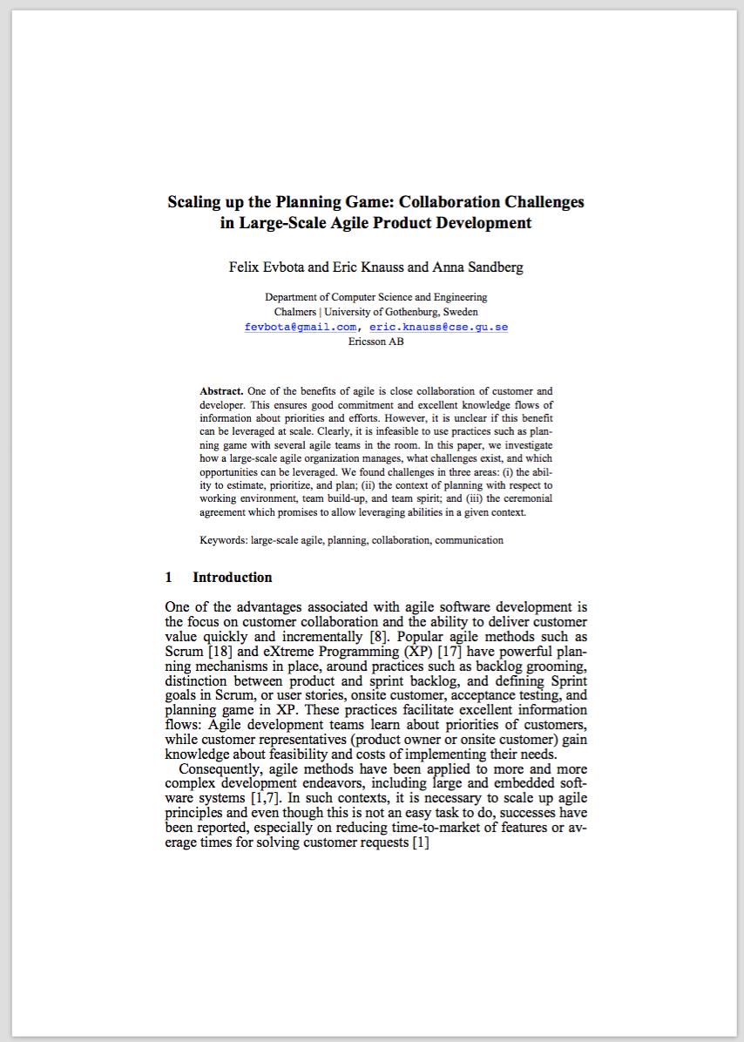
Large-Scale Planning Game
Felix Evbota, Eric Knauss, Anna Sandberg: Scaling up the Planning Game: Collaboration Challenges in Large Scale Agile Product Development. In: Proc. of 17th Int. Conf. on Agile Software Development (XP 2016), Edinburgh, UK, 2016

Slide 56
Understanding Customers and End-users
Large-Scale agile
Agile
Huge distance to customers and end-users
Hierarchy of product owners
Coordinate efforts and dependencies of many teams
Information silos vs. overload
Onsite customer / product owner
User stories facilitate discussions
Planning game to facilitate dialogue between customer and supplier
Cross-functional team offers rich perspective

Slide 57
Findings
Context
Team Spirit
Team Build-up
Work Environment
Research Method
Qualitative Case Study (Ericsson)
10 Semi-Structured interviews with
op. product owner,
line manager,
program leader,
project leader,
release leader,
team leader and
developer
Ceremony Agreement
Estimation Ability
Prioritization Ability
Abilities
Planning Ability

Slide 58
Findings
“[Previously we] estimated on available days in the sprint, that is not a good way because you do not include the unexpected things” [OPO]
“[Sometimes we have a] tester estimating design tasks and a designer estimating test tasks. It is important to know whose estimation should be looked at”. [Line mgr]
Skeptical about estimations
Need to monitor discussions
Estimate tasks that do not fit role
Estimation Ability
Prioritization Ability
Abilities
Planning Ability

Slide 59
Findings
“The challenge is if you have a lot of small backlog you are not in control at all be- cause if you have one common backlog and you decide on a program level, that is how we work [...] if not everything is visible on the common backlog program and only visible in the XFTs backlog then you maybe having a mismatch.” [OPO]
Complex structure of product owners and backlogs
Inconsistencies between backlogs
Lack of transparency
Estimation Ability
Prioritization Ability
Abilities
Planning Ability

Slide 60
Findings
“... we have been working like this for two and half years now, and we are still struggling finding our roles”. [OPO]
”[planning is done by] me as the manager and perhaps with the help of the team leaders sometimes... [unclear] just how much should the team be involved in the planning phase and stuff like that..."
[Line mgr]
Unclear requirements
Unclear role of operational product owner
Involvement of teams
Estimation Ability
Prioritization Ability
Abilities
Planning Ability

Slide 61
Findings
Context
Team Spirit
Team Build-up
Work Environment
Open Space
Disturbing other teams
By-passing operative product owner
“...we have scrum meetings in open office space [...]. You kind of get disturbed when other teams are having their scrum meeting in the open setting. It is better [if] every team has their different rooms.“ [Dev.]

Slide 62
Findings
Context
Team Spirit
Team Build-up
Work Environment
Capabilities of team
Moving team members
Need for broader competence
“[Sometimes] operative product owner has one view and the team has another view [… It] can be a challenge to have the operative product owners to understand what capability a certain team has and he wants much more than they are capable of doing.”

Slide 63
Findings
Context
Team Spirit
Team Build-up
Work Environment
Shared concept of agile
Team maturity
“moving somebody from one team to the other, then you are impacting the team spirit in both teams, you might go back to the team development stage when you get a new team member or lose a new team member”.

Slide 64
Findings
Lack of suitable information channels
Coordination meetings boring or too short
Inadequate anatomy of features
Ceremony Agreement
“The biggest challenge I pick is the coordination of the feature portfolio, [...] on top of getting out features in our program fast and efficient, we need to collaborate on a portfolio basis to align the features over two programs”. [OPO]

Slide 65
Conclusion on Large-Scale Agile Planning
Qualitative Model of what influences agile planning
Overview of key aspects of collaborative planning in large-scale agile development.
Large-scale agile planning not only depends on team abilities or skill, but also on the context in which those teams operate.
Ceremonies and practices on inter-team and inter-product level are currently missing and invite further research.
Outlook: We encourage constructive research to provide improvement for one or several aspects. Our vision is a collection of best, or at least good, practices for each area in out model.

Slide 66
Test Case Selection
Part 3:
Testing Challenges in Continuous Software Engineering

Slide 67
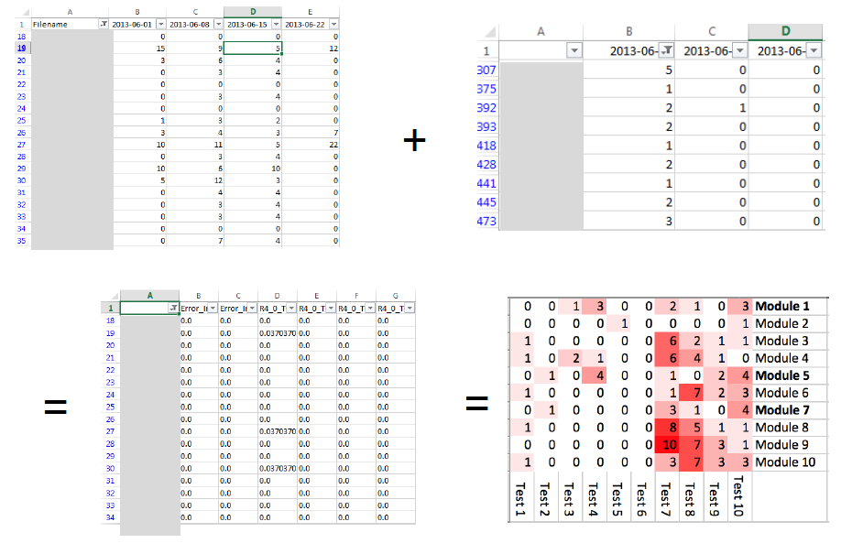
CCTS
The Code-Churn Test Selection model identifies the most optimal test suite based on the changes in the source code
Reduction of test suite by 73% without any loss of effectiveness
Can speed up continuous integration and reduce cycle times
Can be applied at all test levels
E. Knauss, M. Staron, W. Meding, O. Söder, A. Nilsson, M. Castell, “Supporting Continuous Integration by Code-Churn Based Test Selection”, Proceedings of the 2nd International Workshop on Rapid and Continuous Software Engineering (RCoSE), ICSE 2015, Italy.
…
For more information please contact eric.knauss@cse.gu.se, agneta.nilsson@cse.gu.se and/or miroslaw.staron@cse.gu.se

Slide 68
Why test prioritization & selection?
Large product, many integration tests
Days or even weeks to run them all
Continuous X = quick feedback
“We have 2h. Run the most important tests.”
“As a cross-functional team, I want to run important integration tests regularly so that integration will be smooth.”
“As an integration tester, I want to give feedback to developers as quickly as possibe.”

Slide 69
Recommending tests (idea)
Prioritize tests based on heatmap
Collect which modules/components where changed
Sort tests by frequency that the failed in connection with collected changes
Cut off list by some criteria
Notes:
----- Meeting Notes (24/10/14 13:57) -----
look at flip flopping as well

Slide 70
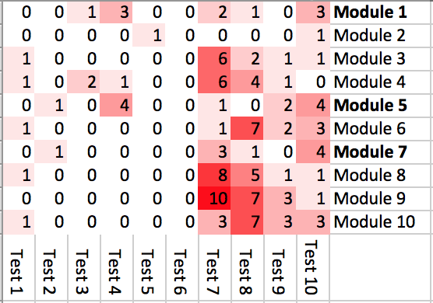
Principle 1
Starting from a heatmap…
…we can understand test efficiency

Slide 71
Principle
We can prioritize these tests (=sorting)
…and select tests.

Slide 72
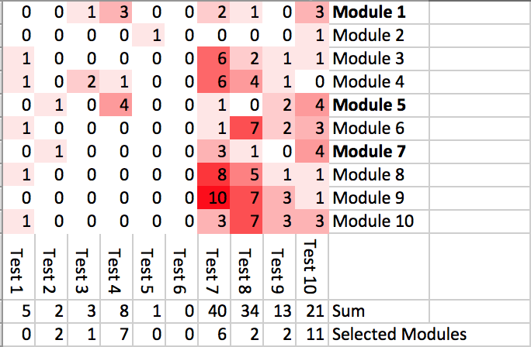
Principle 2
If we know the modules that have recently changed…
…we can characterize test efficiency specifically for these modules

Slide 73
Principle 3
Perhaps a test is not likely to fail, but it would be strategically problematic. Therefore, we can also take into account business value

Slide 74
Applied to realistic data
Optimize the last 13%? But might be larger in your case!
Not a selection problem
Principle 2: Use historical data on code change
Linlin Wang: Implementation and Evaluation of an Automatic Recommender for Integration Test Cases. Master thesis at Chalmers, Gothenburg, Sweden, supervisor: Eric Knauss, examiner: Miroslaw Staron. 2015
Principle 1: Use historical data on test execution
918 Tests, history over one year (255 test executions)
Did not fail last year → don’t run daily

Slide 75
Applied to realistic data (ongoing)
Principle 1: Use historical data on test execution
Did not fail last year → don’t run daily
“You can do that tomorrow!”
Principle 2: Use historical data on code change
Optimize the last 13%? But might be larger in your case!
Still good potential for speedup.
If you apply Principle 2:
Only 6% of the tests that fail were not recommended
Only 23% of the tests we did recommend don’t fail
Overall: Moderate strength recommendations (MCC > 0.2
On average/for on third of the tests: Strong (MCC > 0.4) recommendations

